Slide 1
Node.js
Amrita University

Slide 2
What is Node.js?
Node.js is an open source server framework
Node.js is free
Node.js runs on various platforms (Windows, Linux, Unix, Mac OS X, etc.)
Node.js uses JavaScript on the server

Slide 3
Why Node.js?
Node.js uses asynchronous programming!
A common task for a web server can be to open a file on the server and return the content to the client.
Here is how PHP or ASP handles a file request:
Sends the task to the computer's file system.
Waits while the file system opens and reads the file.
Returns the content to the client.
Ready to handle the next request.
Here is how Node.js handles a file request:
Sends the task to the computer's file system.
Ready to handle the next request.
When the file system has opened and read the file, the server returns the content to the client.

Slide 4
Why Node.js?
Node.js eliminates the waiting, and simply continues with the next request.
Node.js runs single-threaded, non-blocking, asynchronously programming, which is very memory efficient.

Slide 5
What Can Node.js Do?
Node.js can generate dynamic page content
Node.js can create, open, read, write, delete, and close files on the server
Node.js can collect form data
Node.js can add, delete, modify data in your database

Slide 6
What is a Node.js File?
Node.js files contain tasks that will be executed on certain events
A typical event is someone trying to access a port on the server
Node.js files must be initiated on the server before having any effect
Node.js files have extension ".js"

Slide 7
Java EE v/s NodeJS

Slide 8
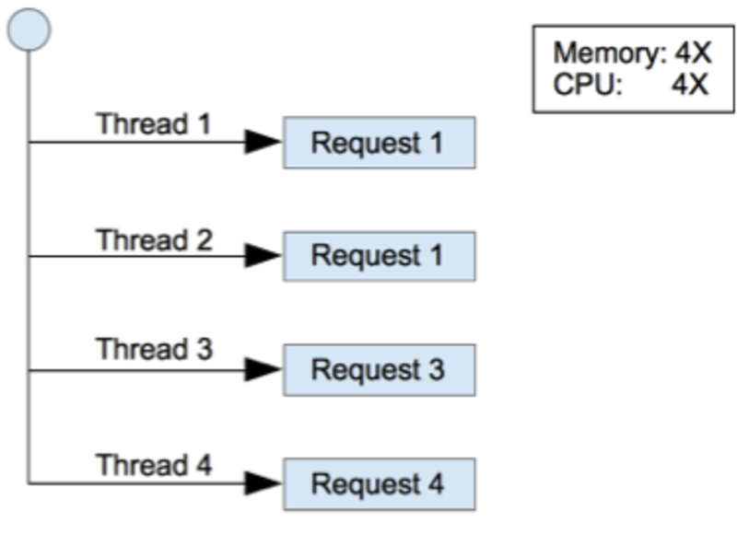
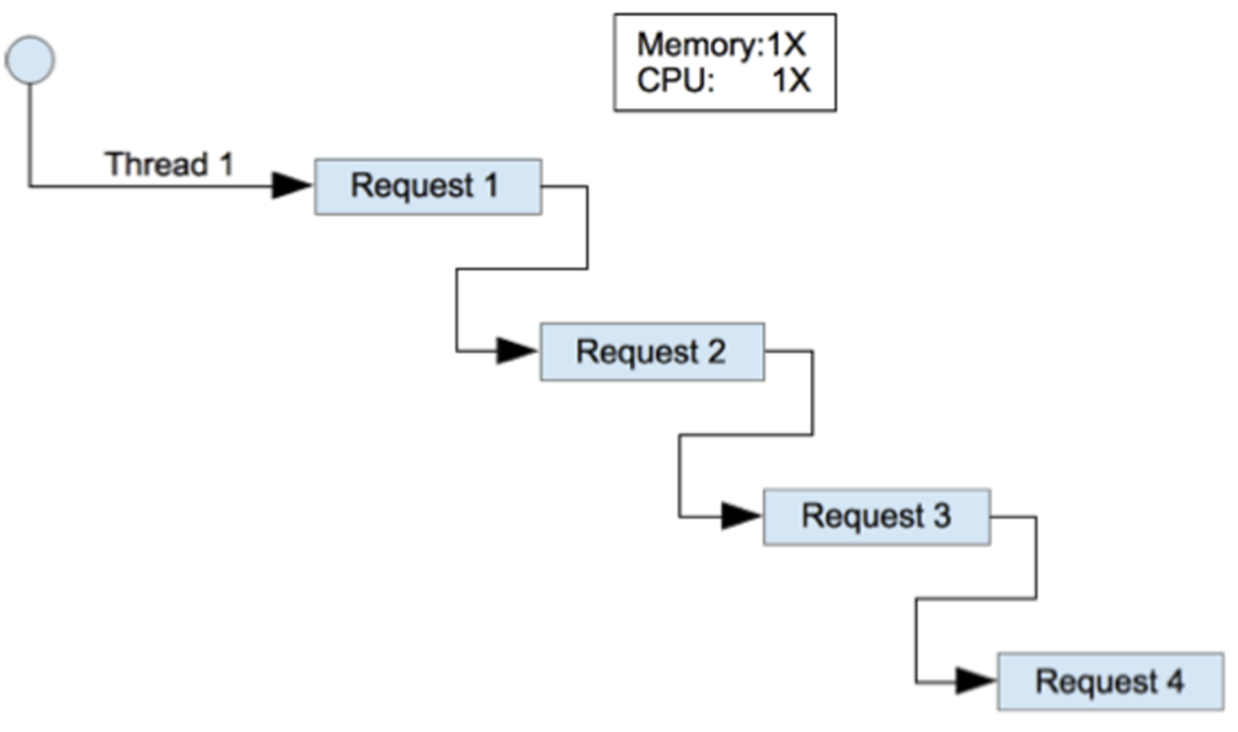
Java vs Node JS Concurrency
Java – Multi-threaded
NodeJS – Single threaded

Slide 9
Multi­-threaded vs Single­ threaded
In a multi­-threaded environment, multiple requests can be concurrently executed, while in a single-­thread environment multiple requests are sequentially executed.
The multi-­threaded environment utilizes more resources.
Multi­threaded environment will be able to handle more requests per second than the single­ threaded environment.
However, in cases where requests involve a lot of I/O such as database or web service calls, each request needs to wait for the external engine to respond to the calls made, and hence the allocated CPU and memory resources are not used during this wait time.

Slide 10
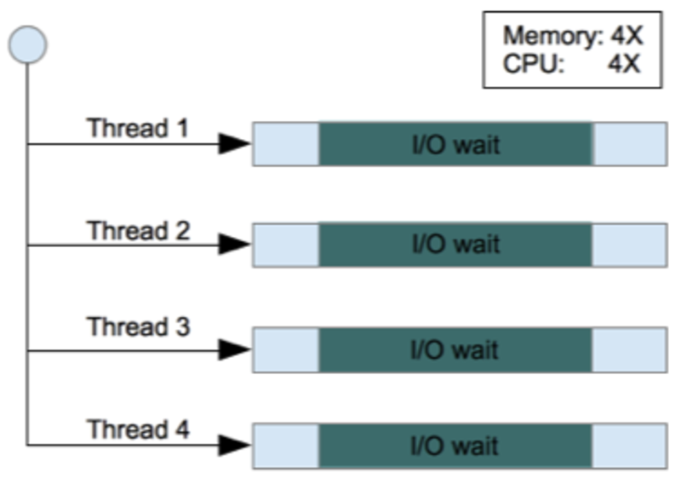
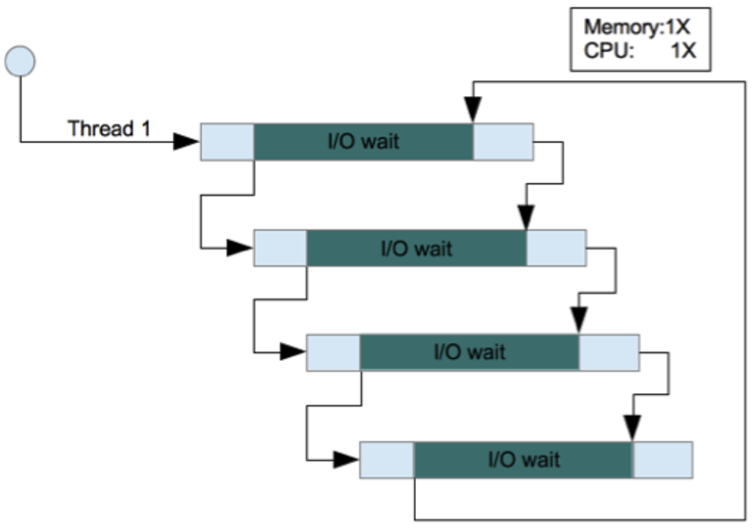
Synchronous v/s Asynchronous I/O
Java -Synchronous I/O
Node Js Asynchronous I/O

Slide 11
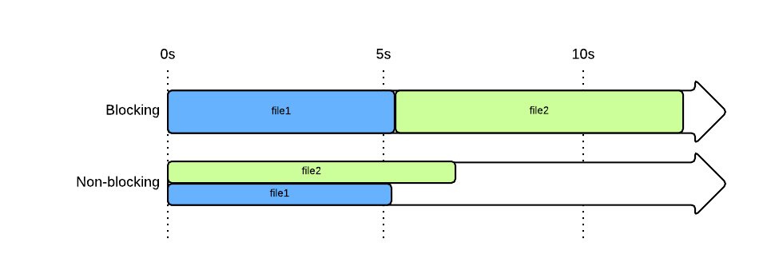
Blocking vs Non Blocking – Example
Long Blocking Operations:
Calls to databases
Calls to web services (ex: Twitter’s API)

Slide 12
Example when a 1000 users concurrently access the web application, for each user request a thread is spawned by the web container
In J2EE
Node.js with its aysnc io
Each thread, does processing, passing control through, various application layers like view, controller, service, data access to finally hit a database or backend, get the relevant data and bring it back to presentation tier from where it may be formatted like an html response and sent back to the client browser as an Http response.
The hundreds/thousands of threads running in the web container, ensure scalability of the application.
But each thread contains synchronous method calls.
Each thread is held up, while the sync call completes.
The best to emphasize this is through a database call such as ResultData data = personDao.updatePersonDetails(person); ( above call blocks till all DB rows are fetched )
Node.js at its simplest and most fundamental level prefers non-blocking function calls, through incessant use of callbacks.
For example the above blocking database call can be simplified logically to the following async call: personDao.updatePersonDetails(person, function(err, numRowsAffected ){....} );
Above call issues request to database driver for update but does not wait for results, it continues to next line of execution, and when the database update has been made, the callback
i.e. the anonymous function gets executed, returning back the error if any and the number of rows affected by the updated.

Slide 13
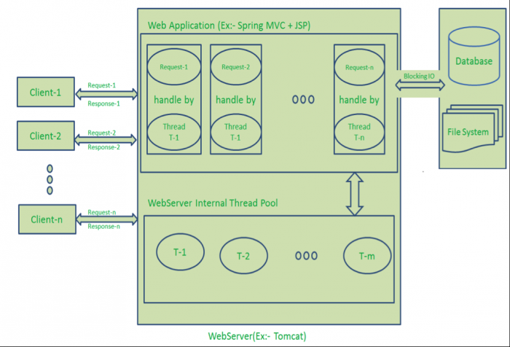
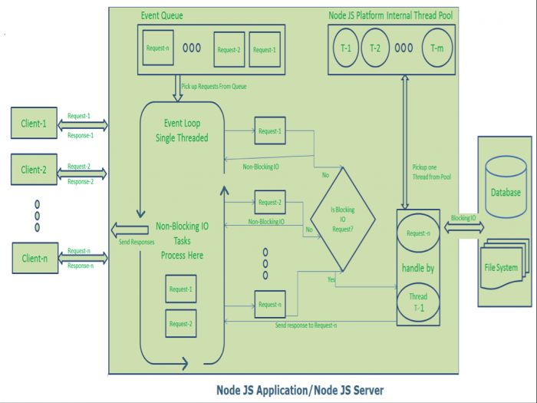
Node JS Single Threaded Event Loop Model
Request/Response Model
Single Threaded Event Loop Model

Slide 14
Node JS Single Threaded Event Loop Model

Slide 15
Node JS Single Threaded Event Loop Model
Handling more and more concurrent client’s request is very easy.
Even though our Node JS Application receives more and more Concurrent client requests, there is no need of creating more and more threads, because of Event loop.
Node JS application uses less Threads so that it can utilize only less resources or memory

Slide 16
Conclusion J2EE vs Node JS
Combining the asynchronous I/O model of NodeJS with inter­process communication in a cluster of processes provides a very high concurrent processing capacity to data processing applications that can be scaled out into a cluster of multiple servers.

Slide 17
Thanks

